Slide 1
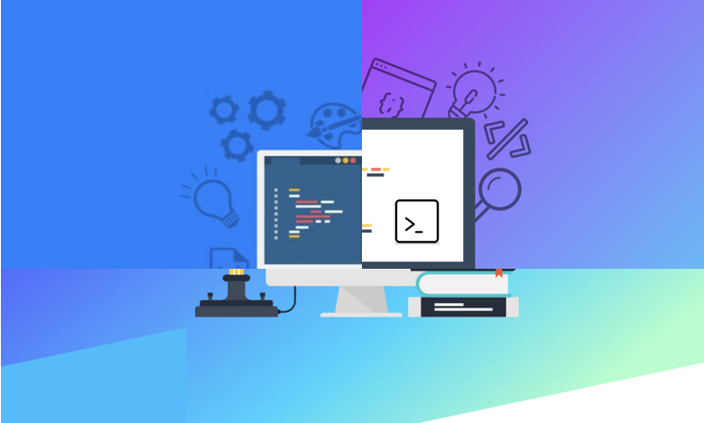






Developer Survey Emerging Skills & Techs
Nijatullah Mansoor
30th, June,20221

Slide 2



OUTLINE
Executive Summary
Introduction
Methodology
Results
Visualization – Charts
Dashboard
Discussion
Findings & Implications
Conclusion
Appendix

Slide 3

EXECUTIVE SUMMARY
Presentation to convey the analysis report that investigate the emerging skill and technology in the IT industry.
Aim of the analysis is to identify the emerging trend in the It industry, pertaining to-
Programing Language
Databases
Software Platform
Web frame
Highest salary in market for programing language
This presentation communicate which may help industry professional and those who want to start carrier in the IT industry.

Slide 4

INTRODUCTION
They adynamic trend of different tools / software’s available for the professional in the IT industry.
Outcome to assist the IT Professional and the recruiter to get a glance on the future expectation.
Professional can up skill based on different emerging tools, programing language, software and many more techs.
The study gives an insight on-
The tope programing language, databases, flatform and web framework in demand of today market.
We also got insight about the tope programing language, databases, flatform and web framework in future.

Slide 5

METHODOLOGY
Data Source
GitHub job posting website
Stack Overflow website
IBM website
Data Exploration and Wrangling
Find and remove duplicate values
Find and remove missing values
Find and fill missing values
Data Normalizing
Identify and handling outlier
Correlation
Data Visualization
Using python libraries (Matplotlib and Seaborn)
Using Cognos Dashboard Embedded

Slide 6
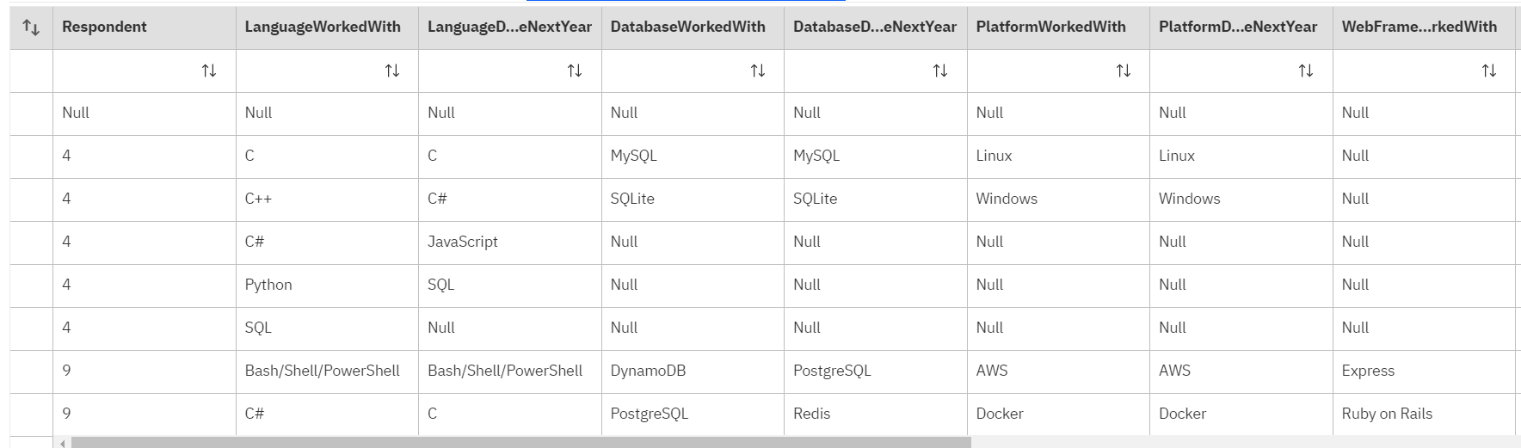
RESULTS
Result derived from the dataset shown above will be presented in the coming slides.

Slide 7
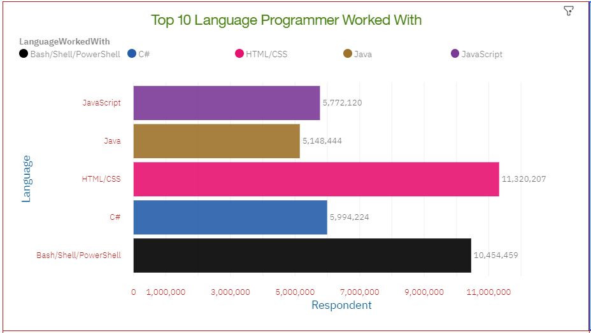
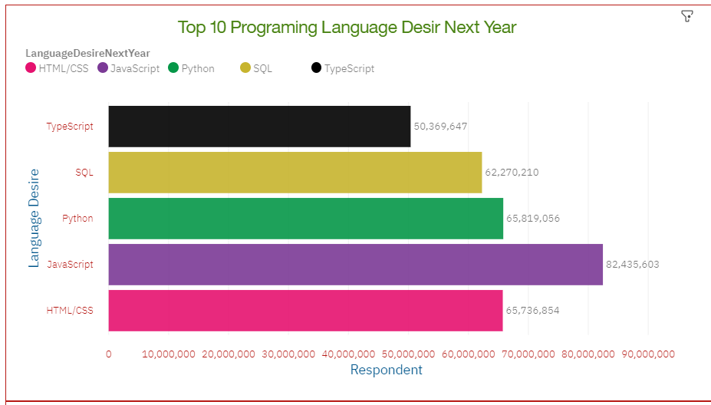
PROGRAMMING LANGUAGE TRENDS
Current Year
Next Year
.

Slide 8
PROGRAMMING LANGUAGE TRENDS - FINDINGS & IMPLICATIONS
Findings
HTML/CSS and bash/shell/PowerShell are most in demand programing language in today market
increase in interest to learn the python, JavaScript amongst developers
C# and Java are not priorities in coming years
Implications
JavaScript, Python, SQL should be give priority to the professional
Training and skill development in python, SQL, and JavaScript can help an organization and professional to keep up with the market trend.
Knowledge of the TypeScript should be added.

Slide 9
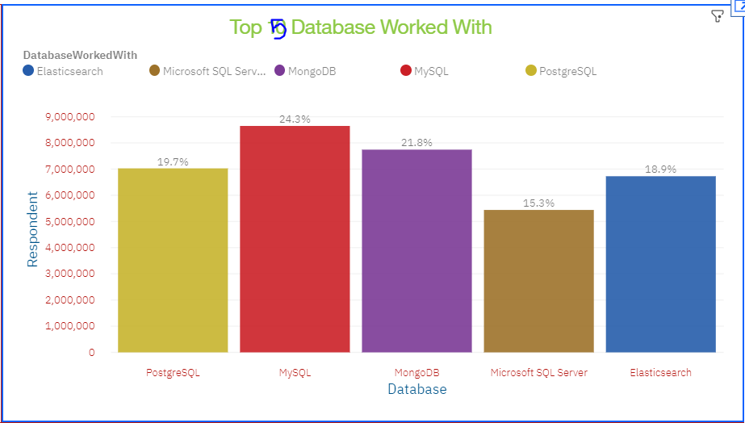
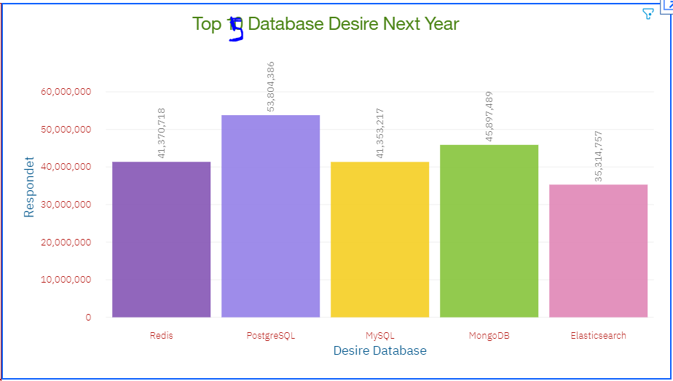
DATABASE TRENDS
Current Year
Next Year

Slide 10
DATABASE TRENDS - FINDINGS & IMPLICATIONS
Findings
MySQL and MongoDB are the most in demand databases.
PostgreSQL is most desired database among other for developers.
MongoDB is the most emerging database for the coming years.
Microsoft SQL server should be not give priorities in the coming years.
Implications
NoSQL database is most desire for the future.
Open source database are more prefer by the companies
Training and skill development in PostgreSQL and NoSQL database can help an organization and professional to keep up with the market trend.
PostgreSQL is most desired in the future

Slide 11

DASHBOARD
The link to access Dashboard created on the Cognos Analytics can be found here

Slide 12
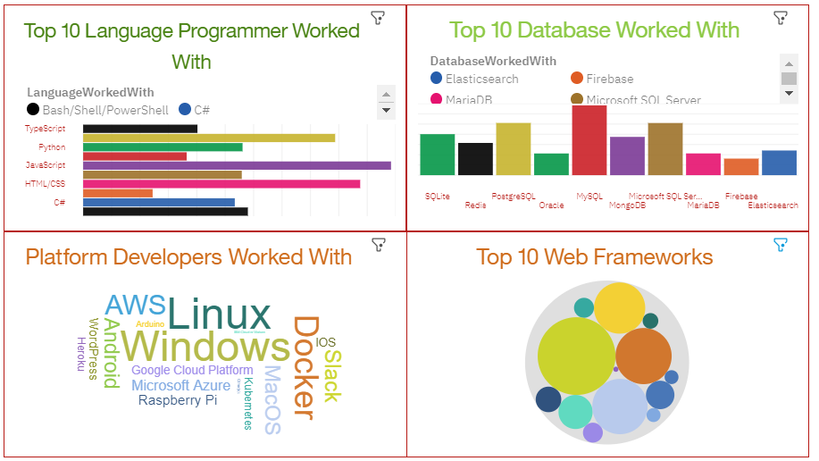
Current Technology Usage

Slide 13
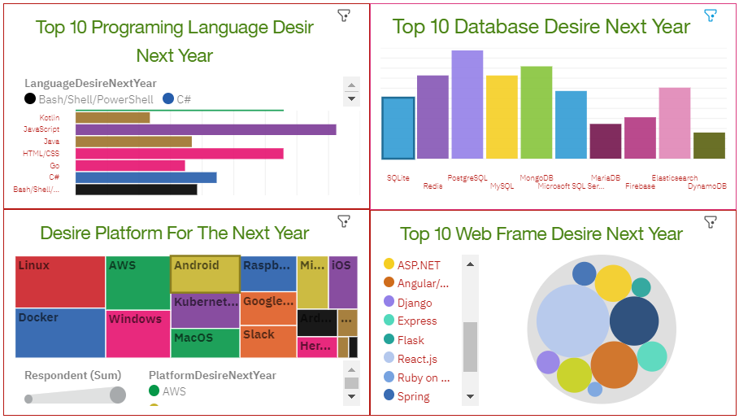
Future Technology Trend

Slide 14
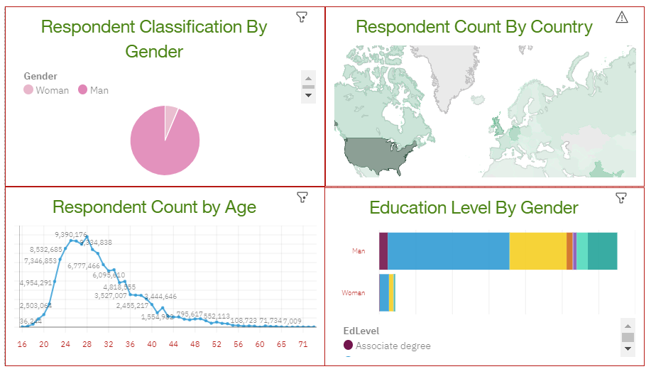
Demographics Usage of Technology

Slide 15
DISCUSSION
Analysis shows Python as most sought after language in the future, same goes for PostgreSQL and NoSQL which are the emerging Databases.
Trend show that Linux, Docker and AWS in growth in the future.
Demographics shows need there is more need for the women in the IT industry.
Most respondent are in 20’s or early 30’s and with full fledged degrees which calls for diversity and to inculcate inclusiveness.

Slide 16
OVERALL FINDINGS & IMPLICATIONS
Findings
Demographic diversification
Increase in number of professional's interest to learn, Python, PostgreSQL, NoSQL database.
Emerging Technologies
Emerging Cloud Technologies.
Implications
Need of spreading IT industry to other Countries of World and women should be motivated in IT industry.
Training professional in Python, PostgreSQL, NoSQL database and cloud can help the company keep up with market trends.
Companies need to adapt trend and upskill professional and keep them motivative and boost performance.
Gain Knowledge on Cloud application.

Slide 17

CONCLUSION
IT industry and professional need to be upskill as per emerging trends and market need.
There is a lots of opportunities for Women in the IT industry.
Inclusiveness of Professionals from all age group and different educational background.
Technological wide-spread could generate more job opportunities around the globe.

Slide 18

APPENDIX
Some interesting findings from the GitHub job posting and popular languages data worth sharing in the coming slides.

Slide 19
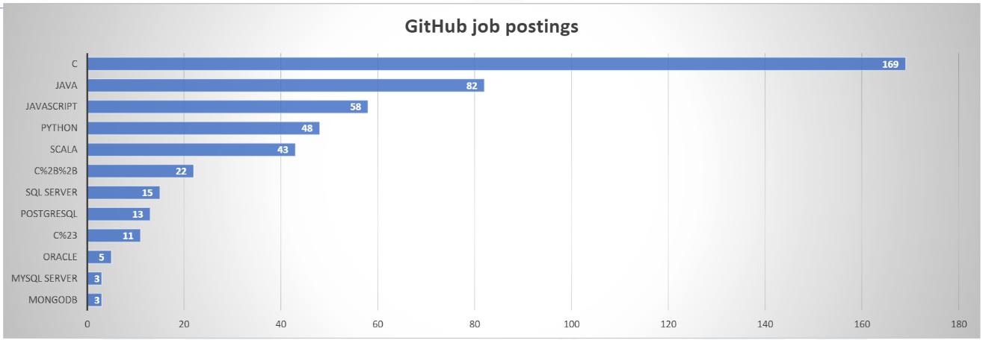
GITHUB JOB POSTINGS
Chart shows that number of job postings on GitHub for C and JAVA languages are the highest but these language are not even in top 5 of 10 languages worked or desired as per the conducted analysis.

Slide 20
POPULAR LANGUAGES
The popular languages data show that the professional who work with SWIFT language are amongst highest paid in the industry followed by professional involved in Python and C++ programing language. Interesting is that SWIFT language was not among the top 10 languages worked or desired as per the conducted analysis.

Slide 21
Thank you !

